Slide 1
Computational Chemistry Methods
Lecture – 6

Slide 2
CONTENTS
Computational Chemistry Methods
○ Ab Initio Methods
○ Density Functional Methods
○ Semi-empirical Methods

Slide 3
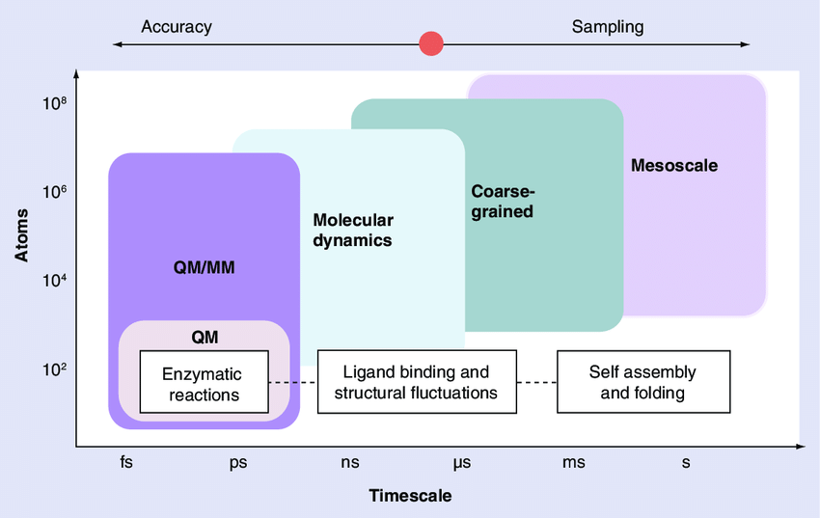
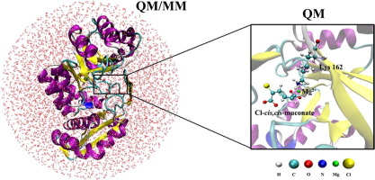
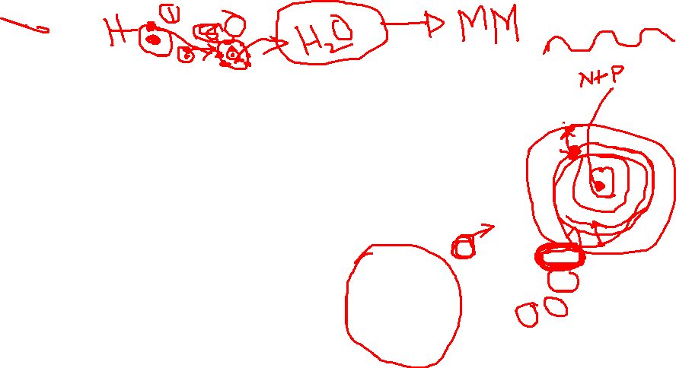
Definition
The main objective of computational chemistry is to solve chemical problems by simulating chemical systems (molecular, biological, materials) in order to provide reliable, accurate and comprehensive information at an atomic level.
To this end, there are two main methodological families: those based on quantum chemical methods and those based on molecular mechanics.
The former are methods in which the electrons are explicitly accounted for, while in the latter their presence is hidden in the force field.

Slide 4
Computational Chemistry Methods
Classical Methods
Quantum chemistry method

Slide 5

Classical Methods
Are those method use Newton mechanics to model molecular system. • Quantum chemistry method:- Which makes use of Quantum mechanics to model the molecular system. This method used different type of approximation to solve Schrödinger’s Equation.
Molecular Mechanics
Molecular Dynamics
Quantum chemistry method:-
Which makes use of Quantum mechanics to model the molecular system. This method used different type of approximation to solve Schrödinger’s Equation.
Quantum Mechanics Methods
Semi empirical Methods.
Ab initio Methods.
Density functional Theory.

Slide 6
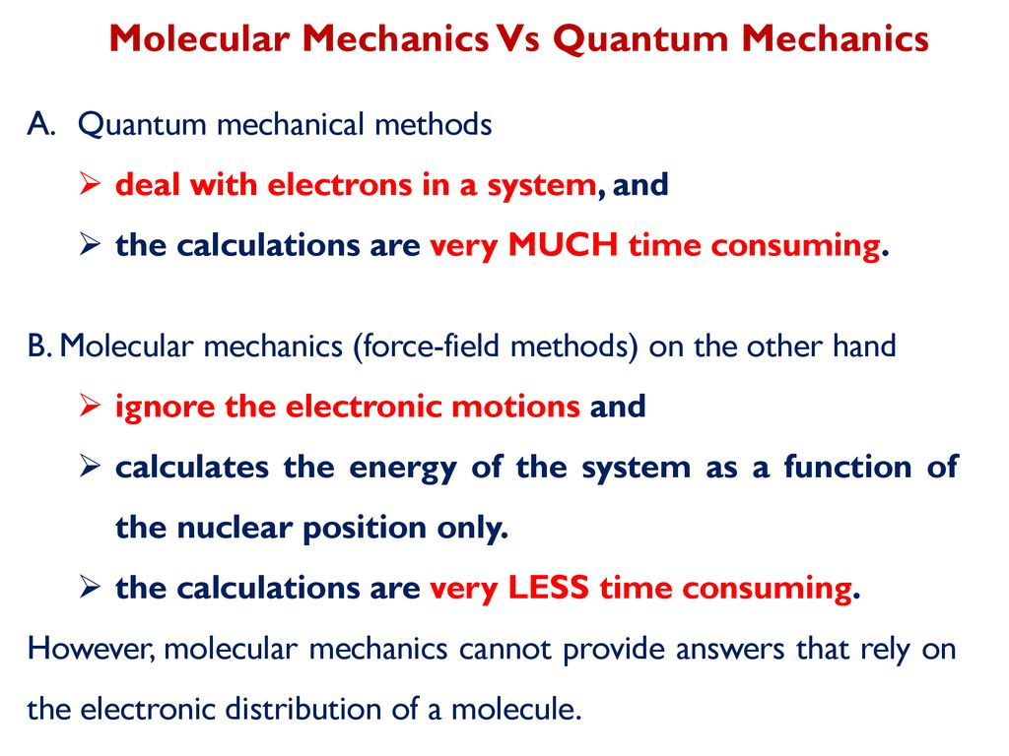

Slide 7
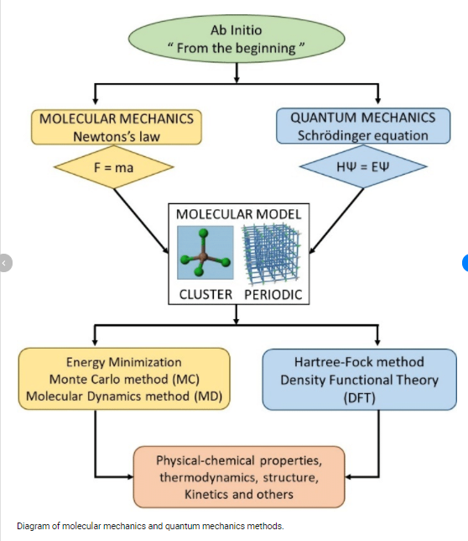


Slide 8
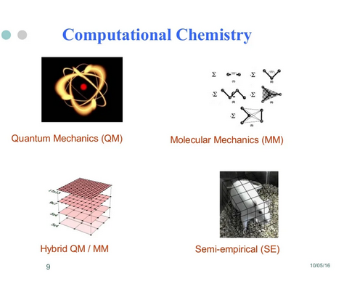


Slide 9
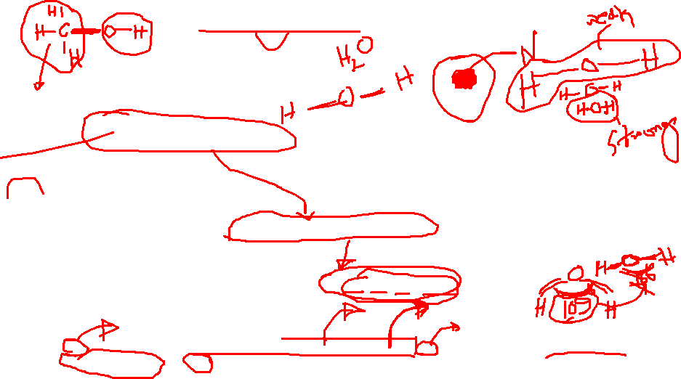
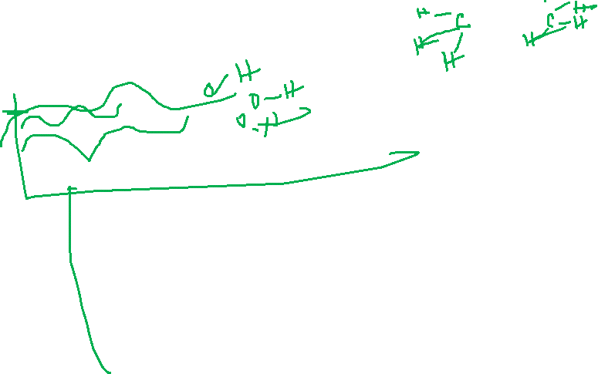
Molecular Mechanics
Molecular Mechanics • Molecular mechanics programs use equations based on classical physics to calculate force fields.
• Atoms treated as spheres, bonds as springs and electron are ignored.
• It assume that the total potential energy (Etotal) of molecule is given by sum of all the energies of attractive and repulsive forces between atom in structure
The molecular mechanics equation E = EB+EA+ED+ENB*
*EB = The energy involved in the deformation bond either by stretching or compression. EA = The energy involved in the angle bending . ED = The torsional angle energy. ENB = The energy involved in the interaction between atoms that are not directly bonded.

Slide 10
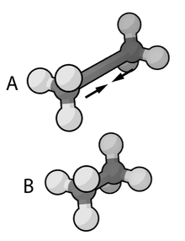
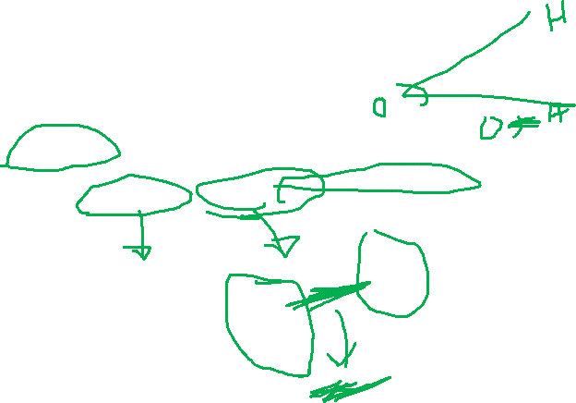
Force Field
Force field refers to calculation of the interaction and energies between different atoms between bond stretching, angle bending

Slide 11

Molecular Dynamics
• Molecular dynamics is a molecular mechanics program designed to mimic the movement of atoms within a molecule.
• Molecular dynamics can be carried out o a molecule to generate different conformation which on energy minimization, give a range of stable conformation. Alternatively bonds can be rotated in a stepwise process to generate different conformation

Slide 12
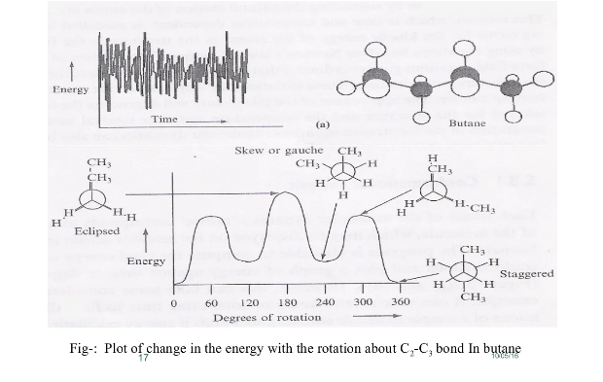
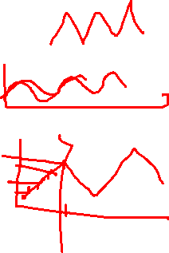
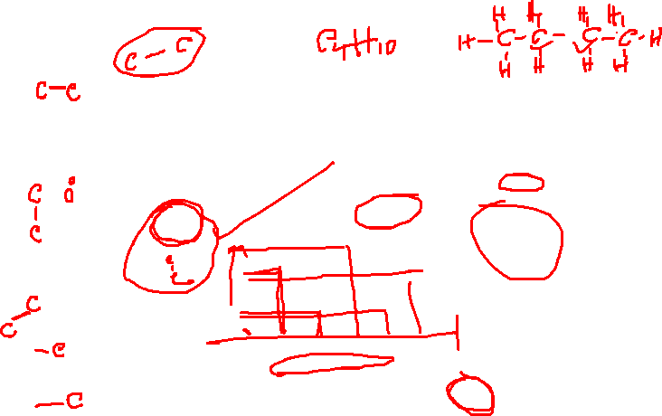

Slide 13
Quantum mechanics
Quantum mechanics is based on arrangement of electrons of molecule and interaction of those electron with electron and nuclei of other molecule.
It based on the realization that electron and all material exhibit wavelike properties.
The Quantum mechanics based on finding solution to Schrödinger wave equation.

Slide 14
Schrödinger’s Equation
The Schrödinger equation is the basis of quantum mechanics and gives a complete description of the electronic structure of a molecule.
Hψ = Eψ
Where H=Hamiltonian operator Ψ =wave fuction E =Energy of the system
Hamiltonian Operator:
accounting for the kinetic and potential energies of the particles constituting the system.
Therefore, the wave function is an eigenfunction of the Hamiltonian operator with corresponding eigenvalue, E.

Slide 15
Ab Initio method
• Ab initio translated from Latin means from “first principles”.
• This refers to the fact that no experimental data is used and computations are based on quantum mechanics.
• It derived directly from theoretical principle
Ab initio methods, as the name implies, require no empirical information about the molecular system being considered but rather apply various approximations to solve Schrödinger's equation through the use of wave functions to describe atomic orbitals for the calculation of molecular properties.
Ab initio quantum chemistry methods attempt to solve the electronic Schrödinger equation given the positions of the nuclei and the number of electrons in order to find/yield useful information such as electron densities, energies and other properties of the system. The ability to run these calculations has enabled theoretical chemists to solve a range of problems

Slide 16
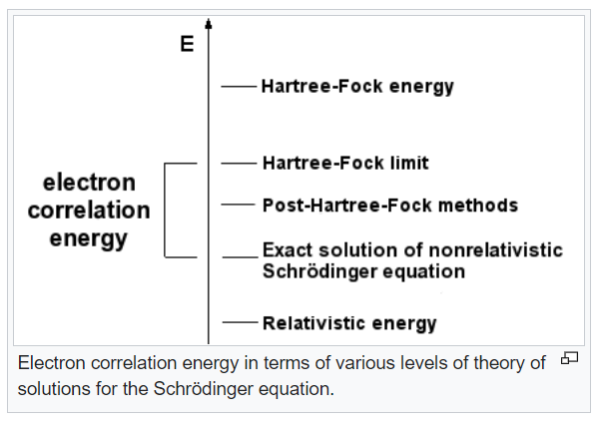
Different Levels of Ab Initio Calculations
Hartree-Fock (HF)
Density Functional Theory (DFT)
Hartree-Fock (HF)
The simplest ab initio calculation.
• It based on Central field approximation
(The central field approximation is developed as a basis for describing the interaction of electrons with the nucleus, and with each other, using perturbation theory).
• The major disadvantage of HF calculations is that electron correlation is not taken into consideration.
Density Functional Theory
Considered an ab initio method, but different from other ab initio methods because the wave function is not used to describe a molecule.
• Density functional theory in which total energy is expressed in term of total electron density is used.
• DFT methods take less computational time than HF calculations and are considered more accurate.
Density-functional theory (DFT) is a successful theory to calculate the electronic structure of atoms, molecules, and solids. Its goal is the quantitative understanding of material properties from the fundamental laws of quantum mechanics.
NB: Electronic correlation is the interaction between electrons in the electronic structure of a quantum system. The correlation energy is a measure of how much the movement of one electron is influenced by the presence of all other electrons.

Slide 17
Semi-empirical quantum methods,
represents a middle road between the mostly qualitative results available from molecular mechanics and the high computationally demanding quantitative results from ab initio methods.
---Uses electron correlation method
---Semiempirical Methods are simplified versions of Hartree-Fock theory using empirical (= derived from experimental data) corrections in order to improve performance.
• Semi empirical methods use experimental data to parameterize equations.
• Like the ab initio methods, a Hamiltonian and wave function are used.
• Less accurate than ab initio methods but also much faster.

Slide 18
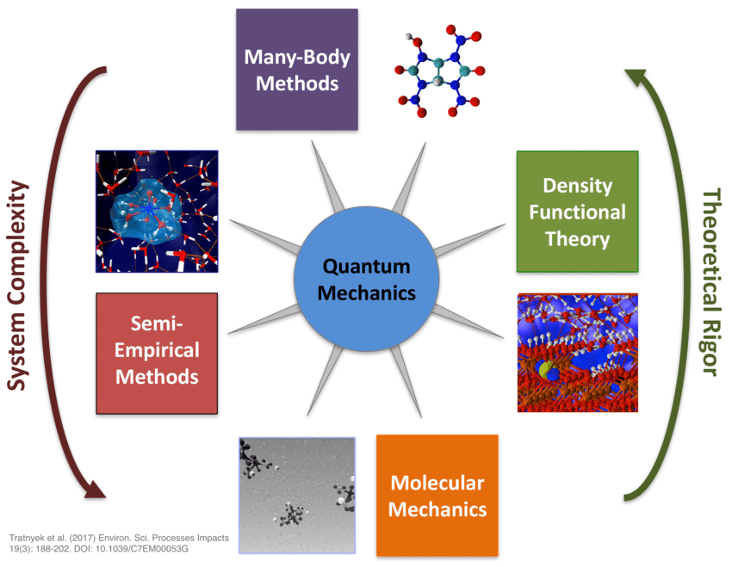

Slide 19
Choice of Method
The method of calculation based on what calculation needs to done and size of molecule. Molecular mechanics useful for
▪ Energy minimization
▪ Identifying stable conformation
▪ Energy calculation for specific conformations
▪ Studying molecular motion
▪ Studying different conformation.

Slide 20
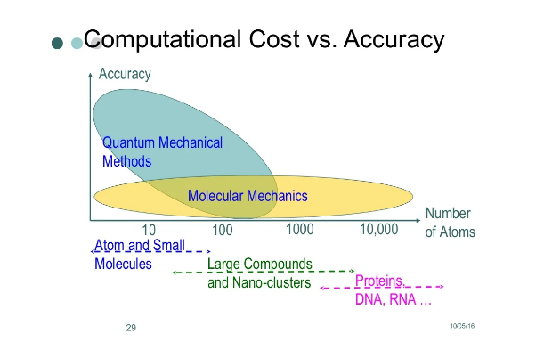

Slide 21


